Slide 1


John Deere Smart Test Analysis
Natalie Boll, Nick Butzler, Audrey Graham, Madelyn Harrington, Hayden Slinger
*Video demos in this presentation are confidential and cannot be accessed or viewed by the public.

Slide 2


Agenda
Overview
Data
Findings
User Interface
Recommendations
Smart Test
Team goal
Metrics
Data structure
Failing tests
Visuals
UI demo
Recommendations based on findings

Slide 3

Overview
What is Smart Test?
A tree like structure of automated tests
Plugs tractor modules into auxiliary hardware & runs multiple tests
Finds defects in parts
If parts do not meet the specified standards, the test fails

Slide 4


What is Our Goal?
To analyze Smart Test data to identify weaknesses in the 6M & 6R Utility Tractor's test performance
Why is the analysis necessary?
Machines are more complex
Increased use of digital technologies
Use automated Smart Test
Identify weaknesses in the assembly processes to improve production capabilities

Slide 5
Analysis metrics measure Smart Test success
First Pass Yield
(FPY)
Process Performance Index
(PPK)
Process Capability Index
(CPK)
Passing percentage for each specific test sequence
Measures variance in overall test performance
Minimum recommended process capability -> 1.33
Measures variance in weekly test performance
Minimum recommended process capability -> 1.33
Find which tests are failing by identifying the data that scores relatively low on metrics

Slide 6
UI Solution Methodology
Problem Identification Tool
Identify a problem at a high level
Drill down into more specific problem areas (specific tests)
View performance statistics
Why is this test not preforming well?
What needs to be changed?

Slide 7
Data Structure and Manipulation
Dropping Rows
Errors in metric Calculation
6R
6M
The initial raw data had over 2,000,000 rows of data
Pass/Fail column created for values that fall between min and max acceptable values
Rows were dropped that contained NA values or values <=0, Accounted for 2,000 rows
Finalized with 53,817 rows
Tests were originally grouped the final test name
Tests from different tractor models had identical test names
Grouping both models created bimodal distributions
.SEQ
.SEQ
.SEQ
.SEQ
S.T.
S.T.
S.T.
S.T.
S.T.
S.T.
The R in 6R is an upgrade to the standard M trim package, 6 is the frame size of the tractor.
Model # 6140R—Frame size 6, 140 horsepower, R trim package

Slide 8

USB Steckdose
Before data cleaning & outlier removal:
‘Beltline’ tests were consistently scoring low on FPY, CPK and PPK.
After cleaning data & removing outliers:
USB Steckdose is the worst performing test based on FPY with an FP of 94.85%
Kraftsteckdoese-ECE-auf RHK is the test whose outcome varies the most with a PPK of 0.13
Discovery of failing test data trends

Slide 9

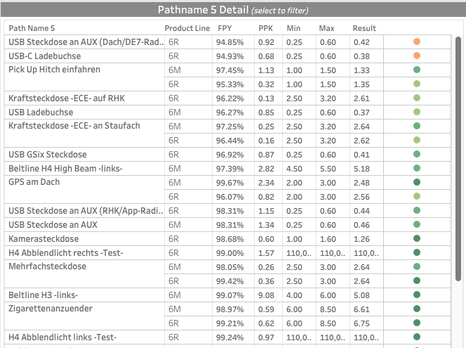
Stakeholders specifically asked for certain statistics on the test level.

Slide 10
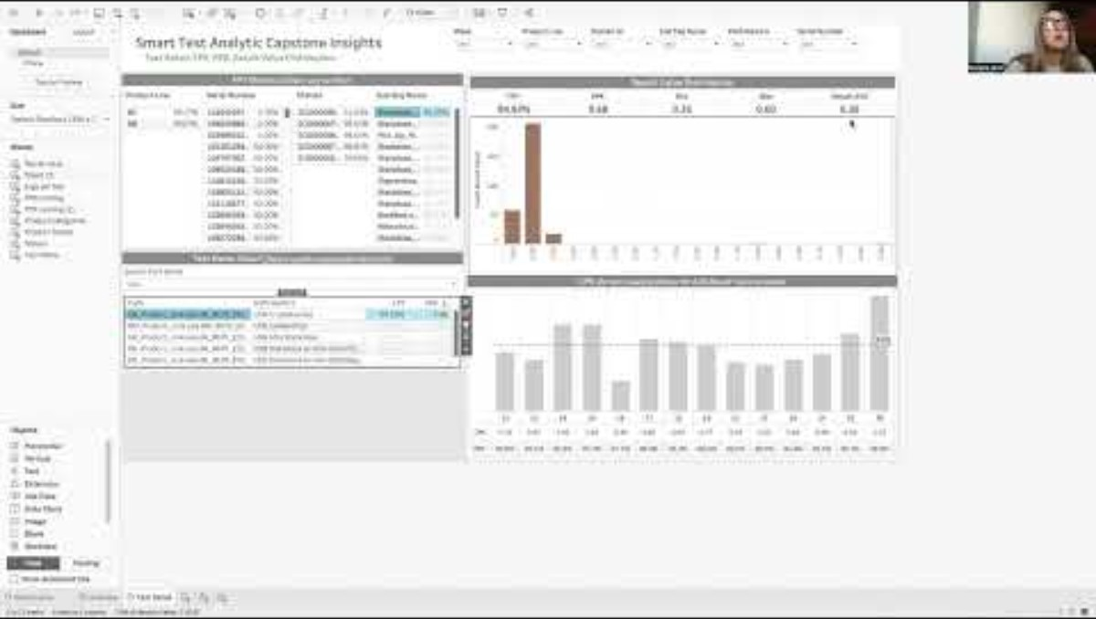

Slide 11
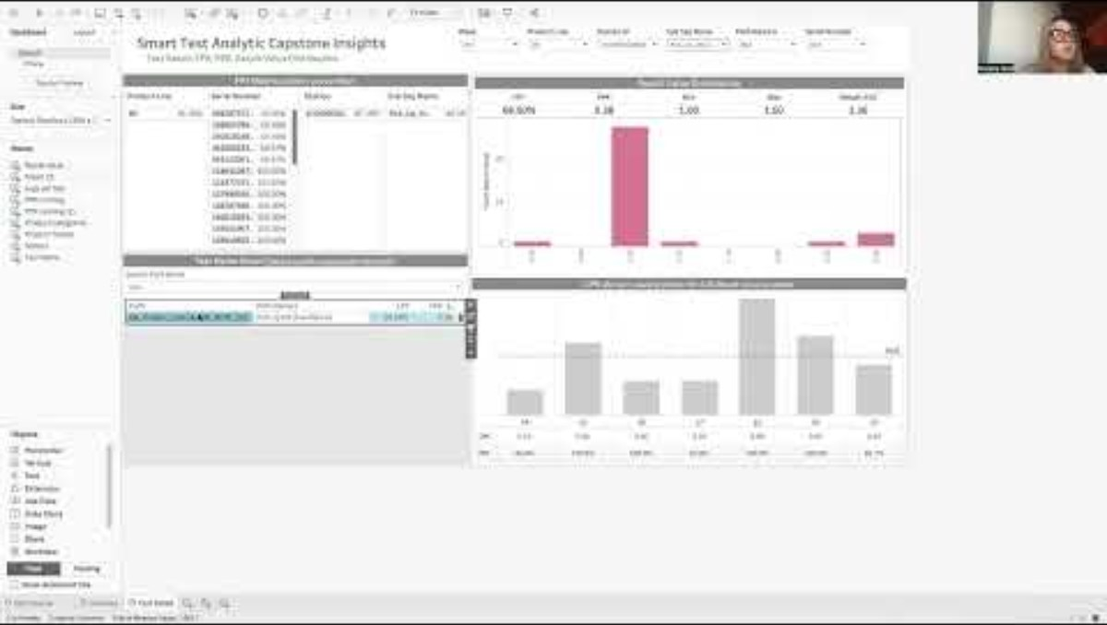
Pich Up Hitch Performance Example

Slide 12
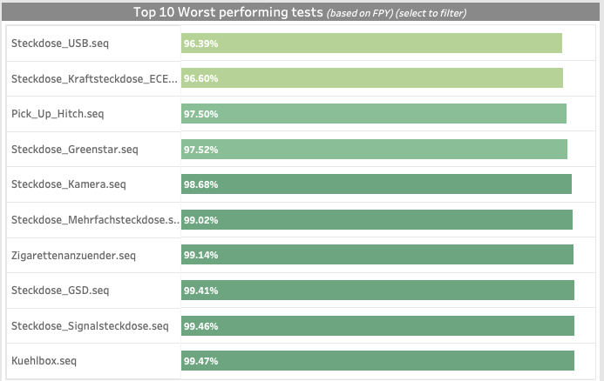
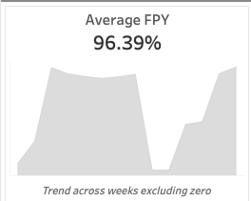
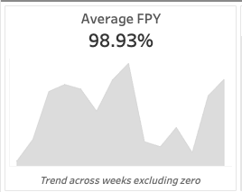
USB Steckdose preforms the worst compared to average first pass yield.
*Steckdose is German for Outlet
USB Steckdose average FPY
Overall average FPY

Slide 13
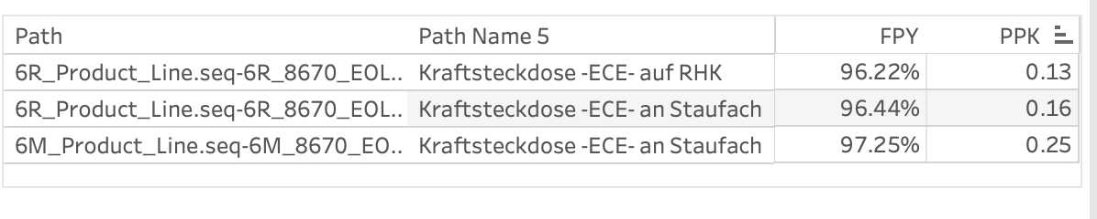
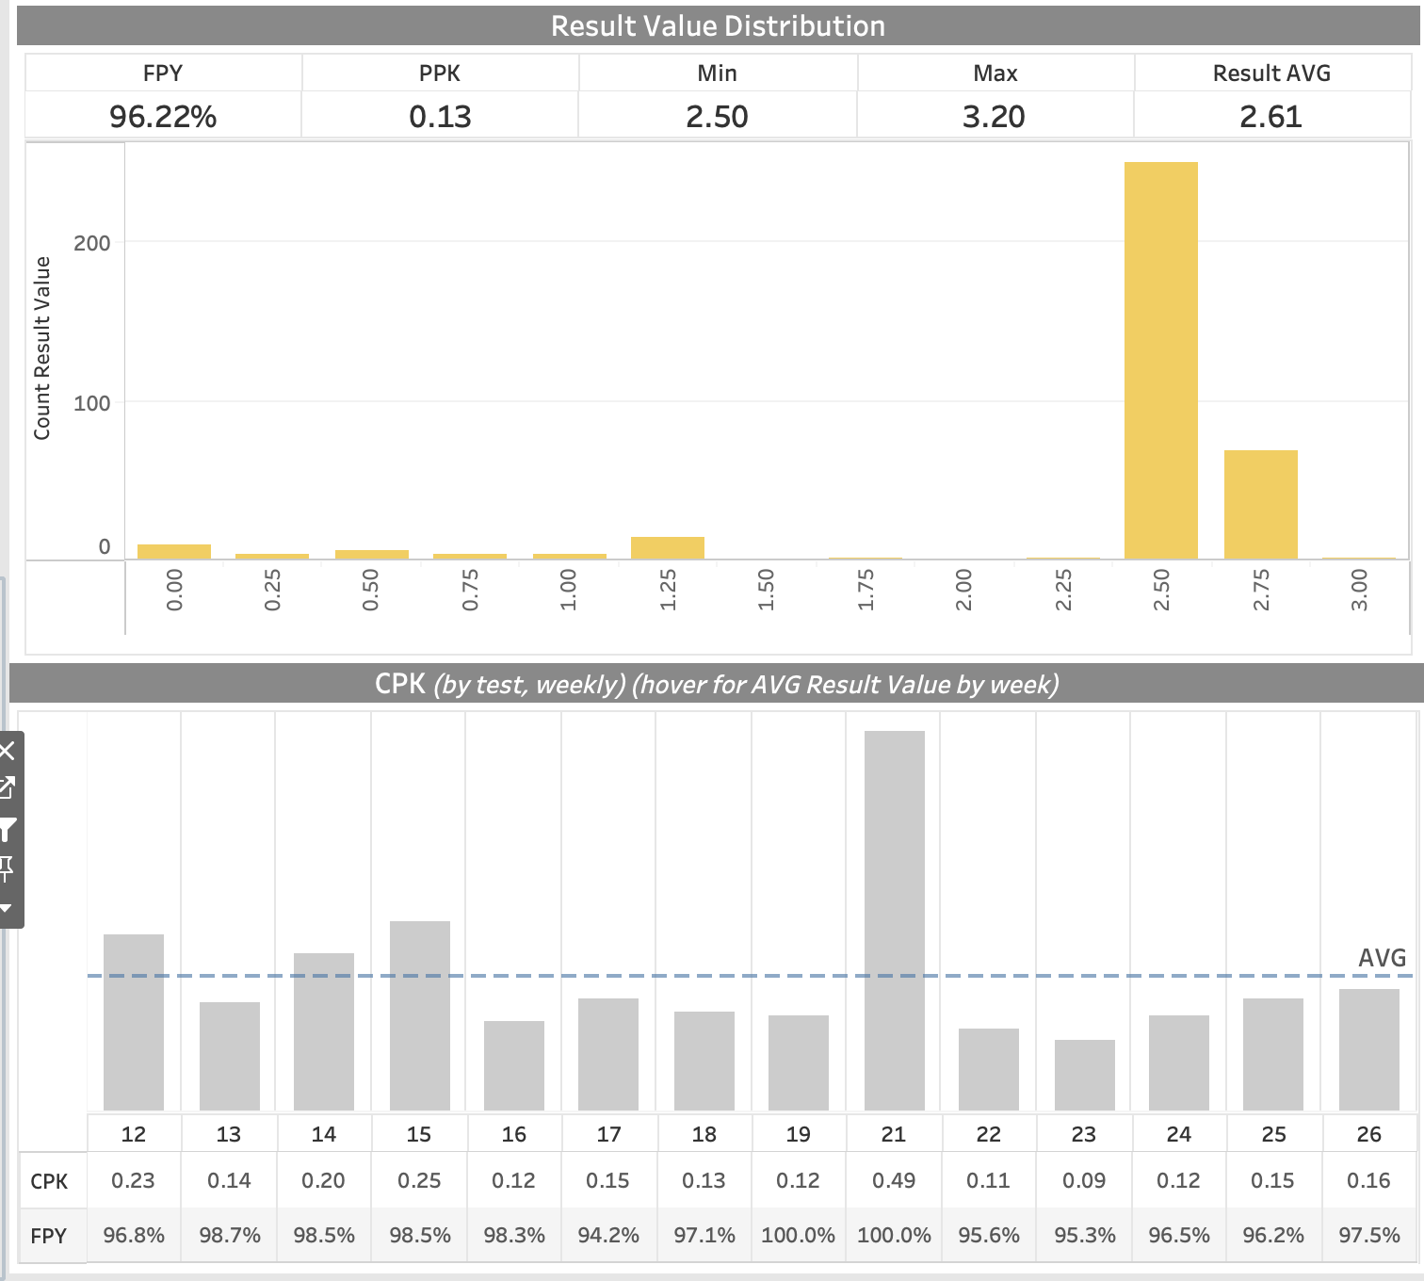
Low PPK's – high variance & skewed to limits:
Power socket ECE on RHK (Kraftsteckdoese-ECE-auf RHK)
We can see this this distribution is skewed towards the lower limit – This may be because lower and upper limits are either not set correctly or that the tests are not performing as expected.
*Steckdose is German for Outlet

Slide 14

Recommendations
Analyze the part difference in the 6R model that cause it to perform worse than the 6M model
Investigate the USB sockets used and find the issue source: supplier’s product quality, installation error, etc
Oversee the process involving Power socket ECE on RHK (Kraftsteckdoese-ECE-auf RHK) to see why there is such a variance in result values

Slide 15
Transferability
Tableau is flexible and can be uploaded to a cloud for company use.
This workbook was built in a way that should be able to pull data from a server live.
Dates are the only field that will need to be worked on.
John Deere engineers can use our R file to clean data into a final output form.

Slide 16
Student Take- aways
Complexity in Data Handling
Statistical Analysis for Quality Control
Strategic Use of Visualization Tools
Enhanced skills in R with handling and analyzing large complex datasets.
Developed proficiency in using Tableau for effective data visualization and decision-making.
Gained practical experience in applying critical quality metrics.

Slide 17
Thank you!
Any Questions?

